Slide 1

COLLEGE SCORECARD
DATA ANALYSIS
Presented by
Pooja Kairamkonda
Priyanga Sreeram
Sakthi Pradeepa Muthukumar

Slide 2



INTRODUCTION
College Scorecard data helps students made informed decisions regarding their higher education
The dataset is adapted from the United States Department of Education and contains university information between 1997 to 2015
In this analysis, questions related to cost of attendance, enrollment rates of different student groups have been answered
Prediction model has been built to predict the average earnings a student may be expected to earn post graduation
LEARN MORE

Slide 3

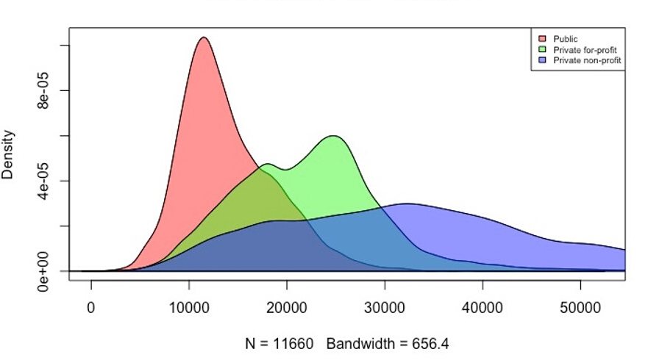

EXPLORATORY DATA ANALYSIS
COST OF ATTEDANCE DISTRIBUTION
PER INSTITUTION TYPE

Slide 4


ADMISSION
RATES
BASED
ON
OWNERSHIP
Table 1. ADMISSION RATES BASED ON INSTITUTION TYPE | Table 1. ADMISSION RATES BASED ON INSTITUTION TYPE | Table 1. ADMISSION RATES BASED ON INSTITUTION TYPE | Table 1. ADMISSION RATES BASED ON INSTITUTION TYPE
VARIABLES | MEAN | SD | MEDIAN
PUBLIC | 0.69 | 0.20 | 0.71
PRIVATE FOR-PROFIT | 0.77 | 0.22 | 0.82
PRIVATE NON-PROFIT | 0.66 | 0.22 | 0.69
Table 2. ADMISSION RATES OVER A DECADE | Table 2. ADMISSION RATES OVER A DECADE | Table 2. ADMISSION RATES OVER A DECADE | Table 2. ADMISSION RATES OVER A DECADE | Table 2. ADMISSION RATES OVER A DECADE | Table 2. ADMISSION RATES OVER A DECADE | Table 2. ADMISSION RATES OVER A DECADE
 | RATE IN 2002 | RATE IN 2002 | RATE IN 2002 | RATE IN 2012 | RATE IN 2012 | RATE IN 2012
VARIABLES | MEAN | SD | MEDIAN | MEAN | SD | MEDIAN
PUBLIC | 0.72 | 0.19 | 0.75 | 0.66 | 0.20 | 0.68
PRIVATE FOR-PROFIT | 0.84 | 0.19 | 0.91 | 0.76 | 0.19 | 0.79
PRIVATE NON-PROFIT | 0.70 | 0.20 | 0.75 | 0.64 | 0.21 | 0.65

Slide 5
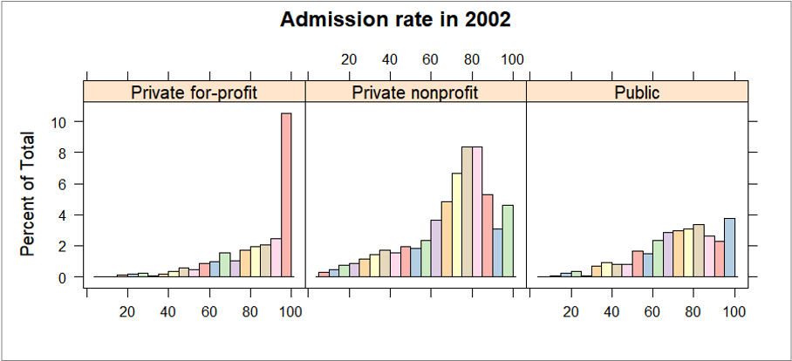


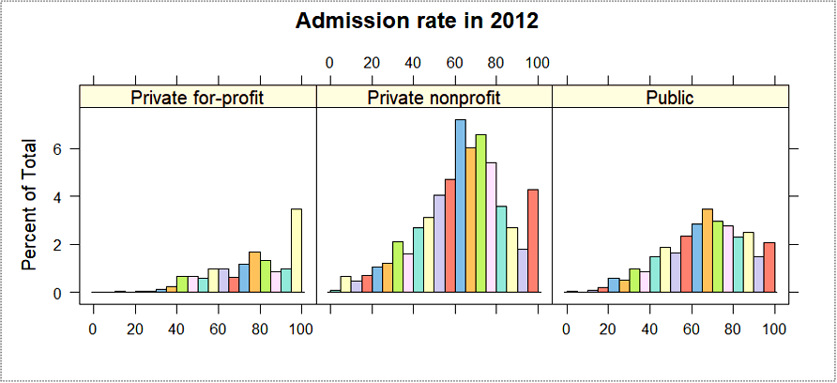



Page 04

Slide 6
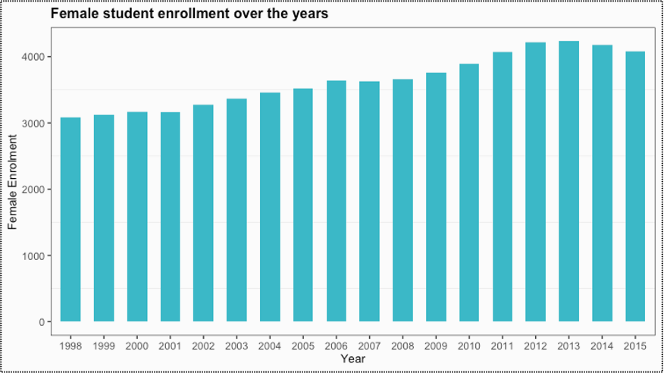


PERCENTAGE OF FEMALE STUDENTS (1998-2015)
80%

Slide 7
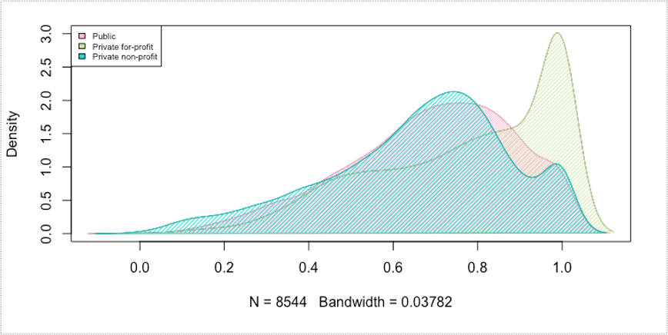


Q1: DOES THE ACCEPTANCE RATE VARY BASED ON THE OWNERSHIP OF THE INSTITUTION?

Slide 8
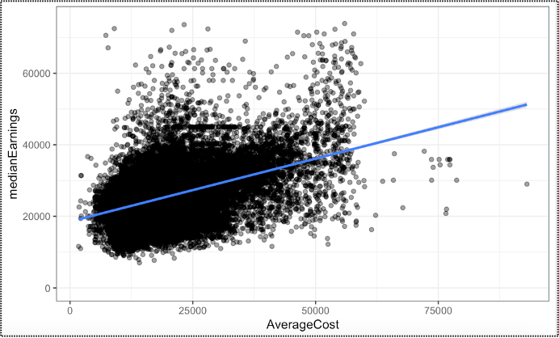
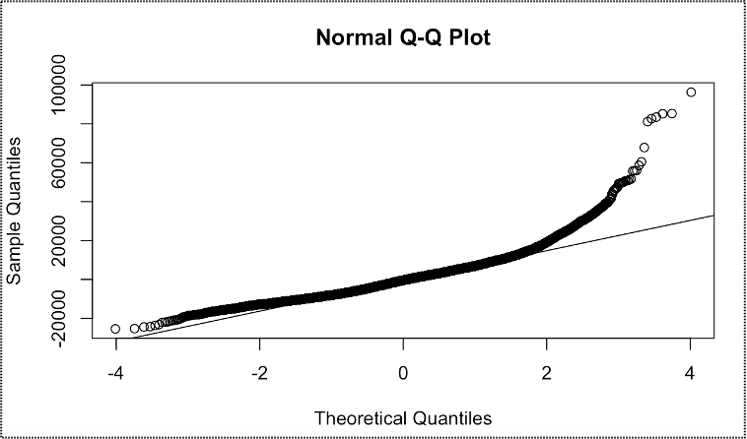
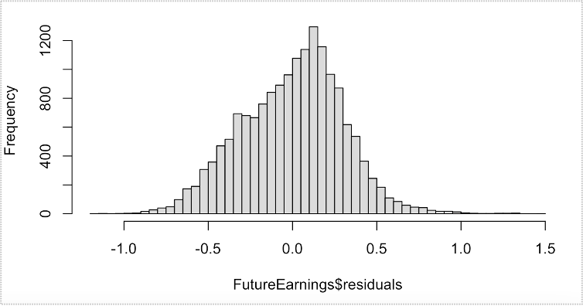


Q2: DO HIGH-COST INSTITUTIONS YIELD HIGHER WAGES FOR STUDENTS?
Relationship between average cost and median earnings
Normal Q-Q plot of residuals
Distribution of residuals after logarithmic function of median earnings

Slide 9
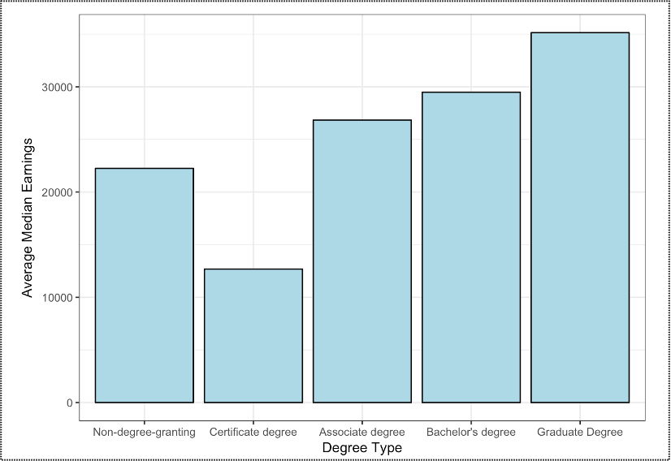



Q3: DOES THE TYPE OF DEGREE PURSUED PLAY A ROLE IN YIELDING HIGHER WAGES FOR STUDENTS?

Slide 10
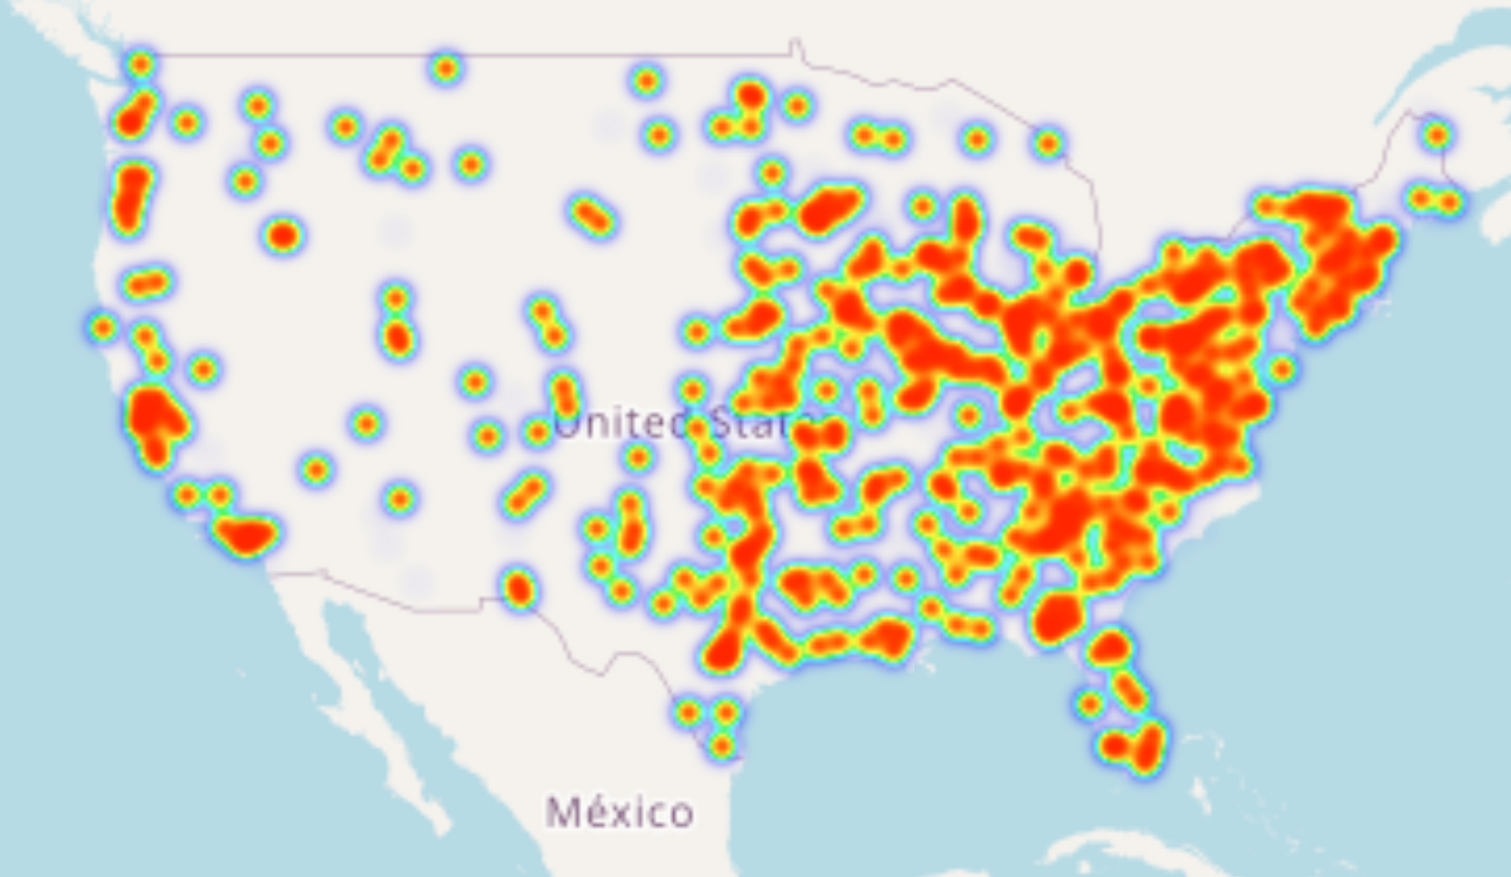



Q4: DOES THE LOCATION OF THE INSTITUTION PLAY A ROLE IN YIELDING HIGHER SALARIES?

Slide 11


ANALYSIS USING LOGISTIC REGRESSION
According to US News & World Report, the median weekly earnings in 2020 for a bachelor's degree was $1,305, for a master's degree was and for a doctoral degree was $1,885 as per the U.S. Bureau of Labor Statistics data.
A prediction model was built to explore how the different variables influenced the median earnings of a student studying any particular degree in a US institution.
Logistic Regression technique was adopted for the analysis with the mean earnings 8 years after graduation (meanearning8yrs) as the outcome variable.

Slide 12

RESULTS OF LOGISTIC REGRESSION ANALYSIS
Table 3. Comparing the AIC values for Model 1 and Model 2 | Table 3. Comparing the AIC values for Model 1 and Model 2 | Table 3. Comparing the AIC values for Model 1 and Model 2
 | MODEL 1 | MODEL 2
AIC VALUE | 403.385 | 383.4931
Table 5. Confusion Matrix Statistics | Table 5. Confusion Matrix Statistics | Table 5. Confusion Matrix Statistics
 | VALUE | % VALUE
ACCURACY | 0.9717 | 97.17
PRECISION | 0.9640 | 96.40
RECALL | 0.9681 | 96.81
SPECIFICITY | 0.9742 | 97.42
Table 4. True Positive & Negative, False Positive & Negative values | Table 4. True Positive & Negative, False Positive & Negative values | Table 4. True Positive & Negative, False Positive & Negative values
 | HIGH | LOW
HIGH | 456 | 15
LOW | 17 | 644

Slide 13
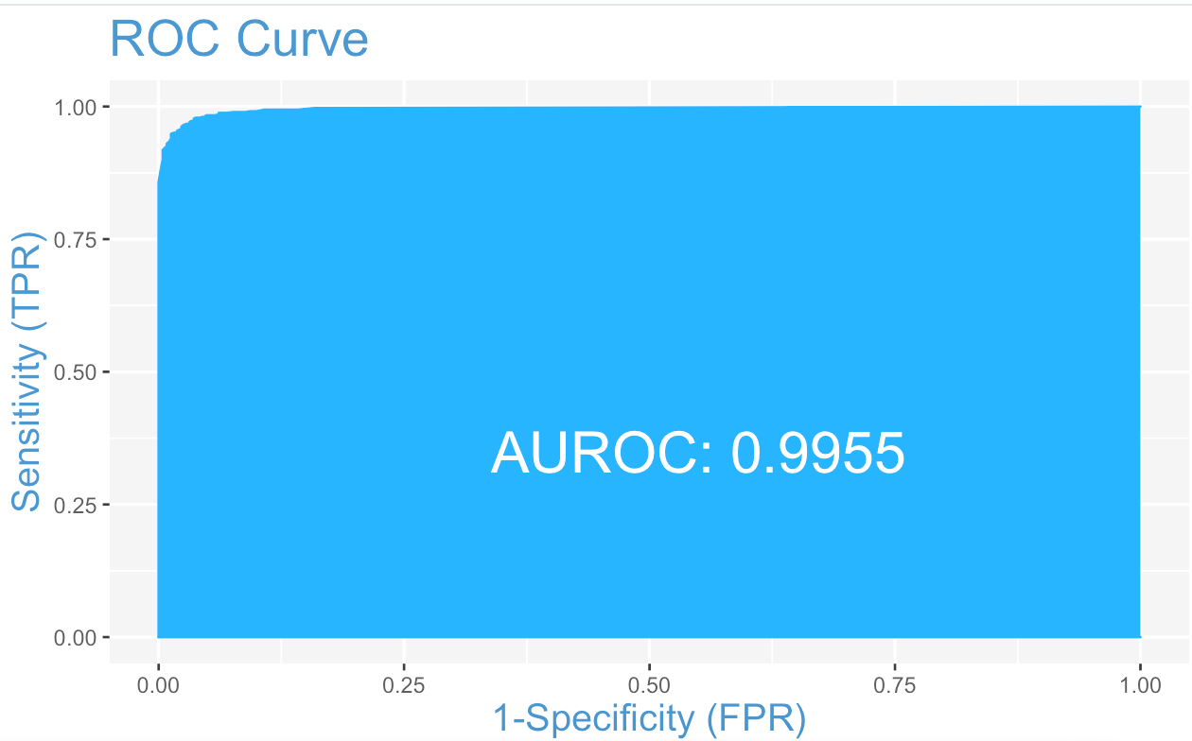


ROC CURVE FOR THE TEST SET

Slide 14
CONCLUSION
Overall, the College Scorecard data tell us about the factors that students consider while planning to apply to universities in the U.S.
By using the Logistic Regression and StepAIC Feature Selection technique, we built a model to predict mean earnings which yielded an accuracy of around 97%.
Important variables - Instate & Outstate tuition fees, Location, Undergraduate enrollment, median earnings, percentage of white, black, Asian, and Hispanic people enrolled
A student is likely to earn a higher income after a graduate degree, and when they are enrolled in a reputed university.
Universities in the northeastern part of the country have majority of graduate institutions and yield students with higher salaries.
Students will also be able to close out debts earlier when their mean earnings are higher.

Slide 15
REFERENCES
[1] U.S Department of Education College Scorecard. Retrieved from: https://collegescorecard.ed.gov/data
[2] Bluman G. Allan (2018). Elementary Statistics: A Step by Step Approach. Eighth Edition. New York, NY: McGraw-Hill Education.
[3] Yaohui Zeng, Patrick Breheny. (2018) The biglasso Package: A Memory- and Computation-Efficient Solver for Lasso Model Fitting with Big Data in R. Journal of Statistical Software. Retrieved from 12 https://arxiv.org/pdf/1701.05936.pdf
[4] Alex (March 2019). The QQ Plot in Linear Regression. BOOSTEDML. Retrived from - https://boostedml.com/
[5] Bassalat Sajjad (June 2017). LASSO regression in R exercises. Retrieved from - https://www.r?exercises.com/2017/06/12/lasso-regression-in-r-exercises.
[6] Selva Prabhakaran. Logistic Regression. r-statistics.co. Retrieved from - http://r-statistics.co/Logistic?Regression-With-R.html

Slide 16

THANK YOU

